Slide 1
Introduction to Cloud Computing

Slide 2
Introduction

Slide 3
Course
Marks Distribution
Contact

Slide 4
Question
How much or what are the cloud services that you know or have used for your applications?

Slide 5
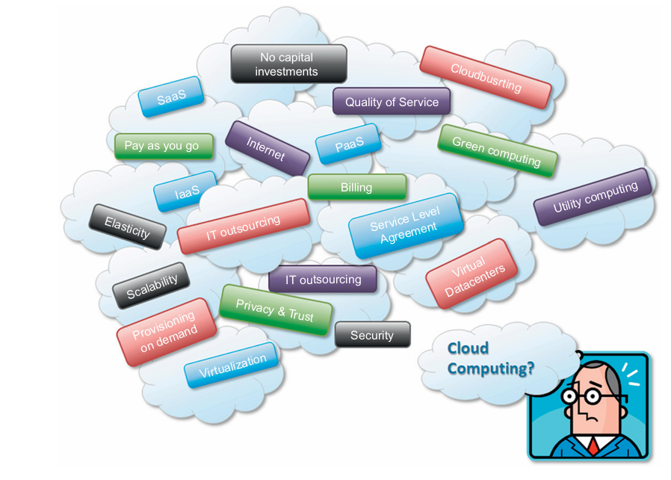
Cloud Computing

Slide 6
NIST definition
Cloud computing is a model for enabling ubiquitous, convenient, on-demand network access to a shared pool of configurable computing resources (e.g., networks, servers, storage, applications, and services) that can be rapidly provisioned and released with minimal management effort or service provider interaction.

Slide 7
Service definition in Cloud Computing
The service is accessible via a Web browser (nonproprietary) or a Web services application programming interface (API).
Zero capital expenditure is necessary to get started.
You pay only for what you use as you use it.
In this case users subscribe to the service and establish with the service provider a service-level agreement (SLA) defining the quality-of-service parameters under which the service is delivered.

Slide 8
System of Cloud Computing
A cloud is a type of parallel and distributed system consisting of a collection of interconnected and virtualized computers that are dynamically provisioned and presented as one or more unified computing resources based on service-level agreements established through negotiation between the service provider and consumers.

Slide 9
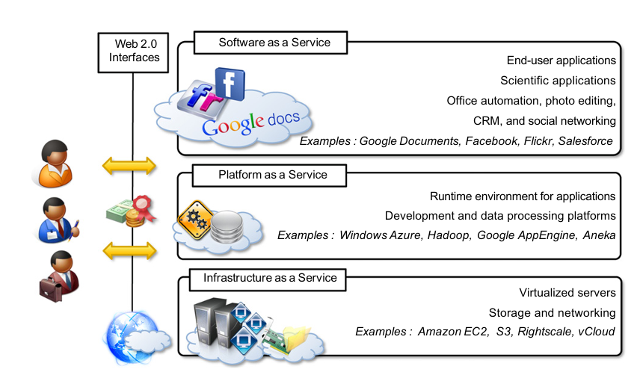
Cloud Computing Reference Model

Slide 10
Win-Win situation for CSCs, CSPs
No up-front commitments
On-demand access
Nice pricing
Simplified application acceleration and scalability
Efficient resource allocation
Energy efficiency
Seamless creation and use of third-party services

Slide 11
Distributed Systems
A distributed system is a collection of independent computers that appears to its users as a single coherent system.
Characteristics of Distributed Systems
heterogeneity,
openness,
scalability,
transparency,
concurrency,
continuous availability,
independent failures.

Slide 12
Cloud Infra Structure and System Development
DC
Isolation
SO
Web

Slide 13
Historical Development :Home Task
Mainframes
Clusters
Grids

Slide 14
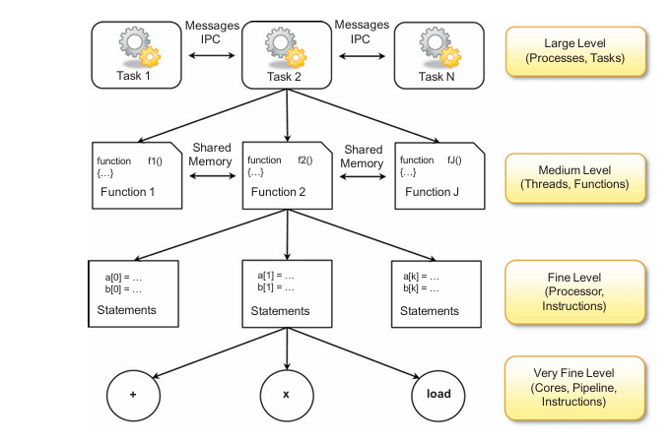
Parallelism vs Sequential Computation
Shared vs Distributed memory

Slide 15
Elements of Distributed Computing
A distributed system is a collection of independent computers that appears to its users as a single coherent system
Communication ?
Software architect ?
Data-flow Architectures
Batch sequential : composed of sequences
Pipe filter style : express activity of a software system as data streams.
Repository architectural
Knowledge sources: update knowledge base
Blackboard: represent data structure shared with KB
Control : collection of rules, procedures
Virtual machine architectures:
Rule based Style: abstract execution environment as an interface:
Interpreter style : with an interpretation engine having internal memory with pseudo code

Slide 16
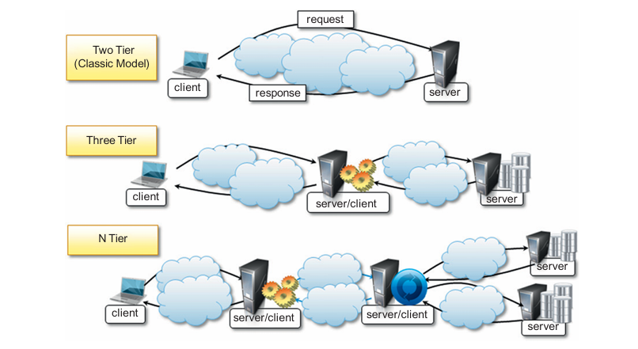
System architectures
Client/ server
Thin client model
Fat client model
Two tier architecture
Three.. N tiers architectures
Peer to peer

